Slide 1
Companion
by : Jorge, Citlally, Nikkita, Hunter

Slide 2
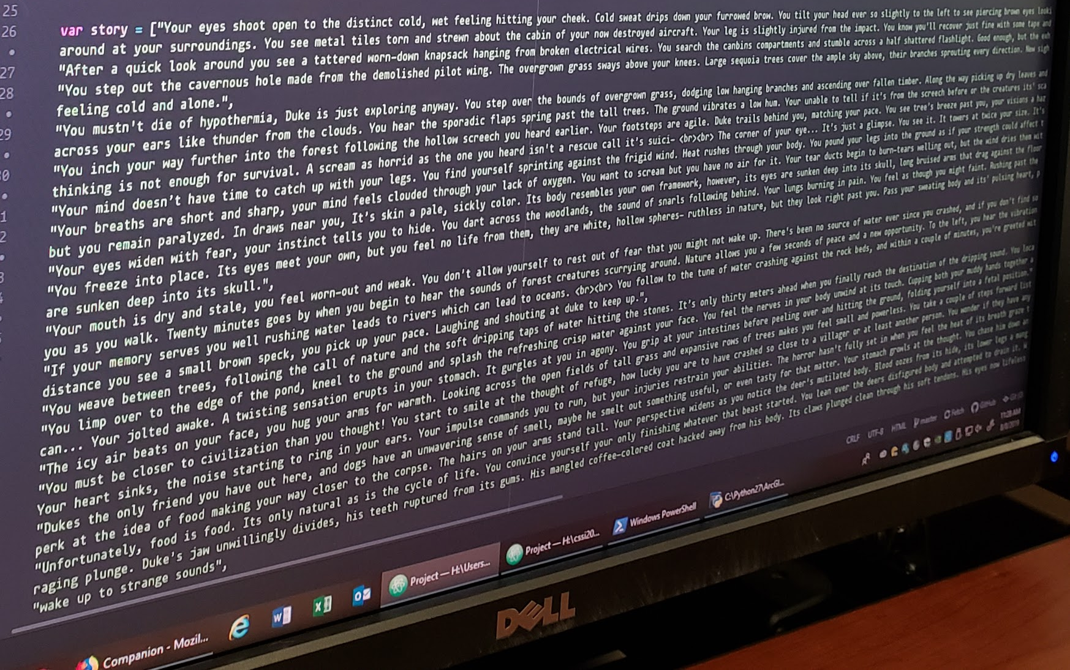
Day 4 (Morning Update)
Home button/page completed
Story is finished, but need to insert it to HTML file
Adding additional features
Fonts
Sounds
Music
Background Images

